Slide 1
Newchurch Village Community Association

Slide 2
There are four areas we wish to register in Newchurch:-
1).The Bowling Green at The Boars Head
2). The Car Park at the Boars Head
3). The Little Park
4). The Car Park off Old Street, adjacent to the North side of St. Nicholas' Church.

Slide 3
4). The Car Park off Old Street, Newchurch

Slide 4
Aerial View of Site

Slide 5
The Car Park is off Old Street, flanked by St. Nicholas' Church to its south. The first church was thought to be made of wood and erected in 1511, and it was rebuilt in stone in 1561 in the reign of Queen Elizabeth I.
This was replaced by the current building, dated 1825 over the west door, which is believed to have been constructed by the parishioners themselves without the benefit of an architect. The chancel was added in 1897 by R.B. Preston
It is a Grade II* listed building.

Slide 6
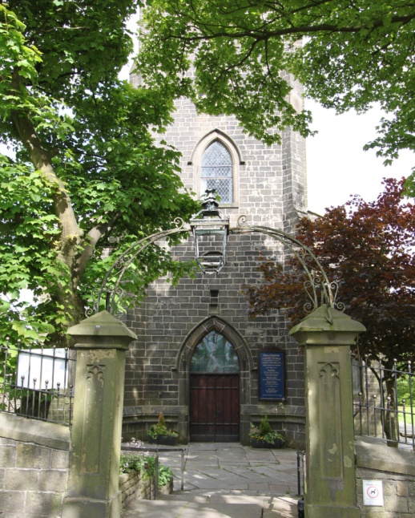
St Nicholas Church, Newchurch

Slide 7
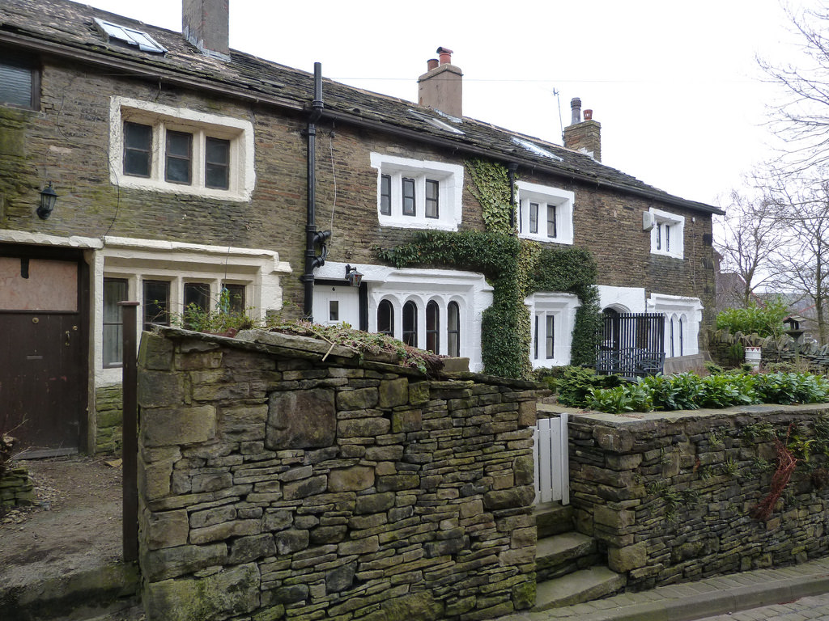
To the north are three cottages, believed to be the original Elizabethan schoolhouse, with stone mullioned windows and other period features.

Slide 8
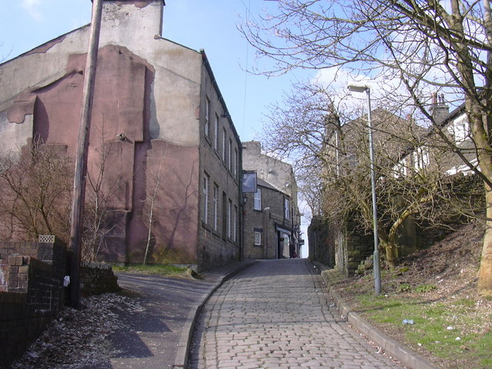
To the east is the former Blue Bell public house.

Slide 9
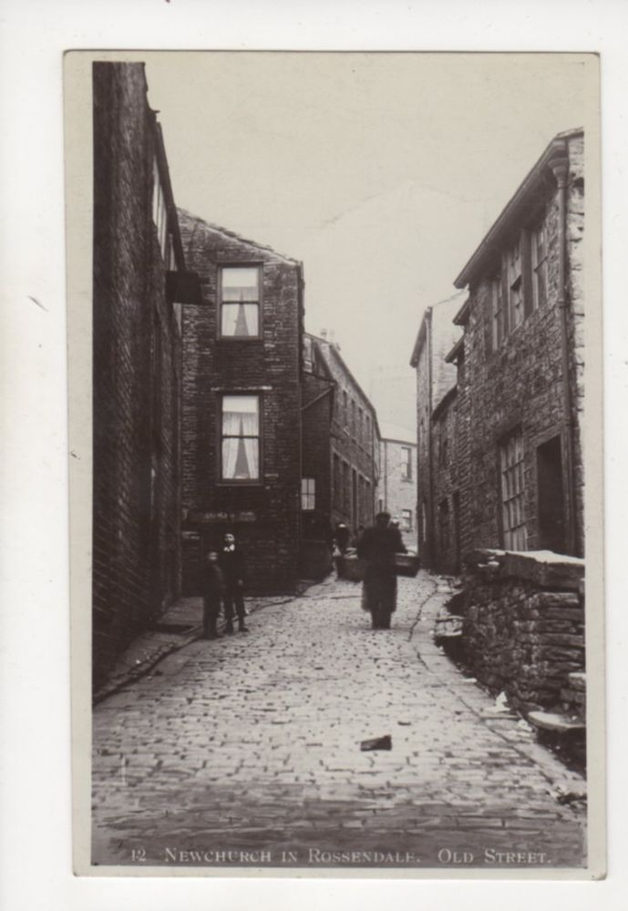
The car park is a result of the demolition that took place in the 1960’s in Newchurch, and is on the site of former houses.

Slide 10
The Car Park, Newchurch

Slide 11
The Car Park, Newchurch

Slide 12
The Car Park, Newchurch

Slide 13
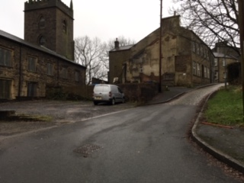
The Car Park, Newchurch

Slide 14
Newchurch Village Community Association

